Slide 1
HWA - Project
By Gabriel Jose

Slide 2
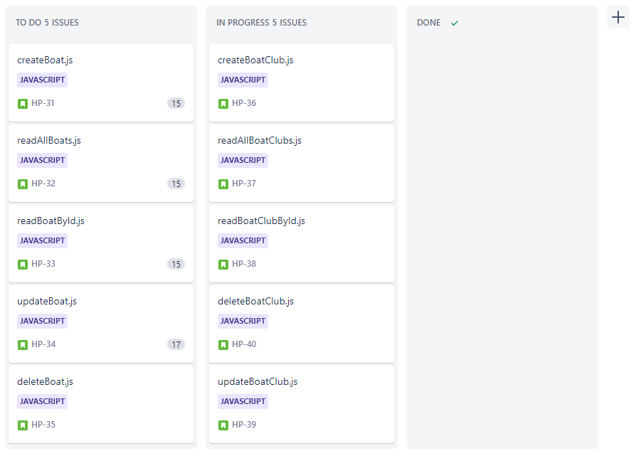
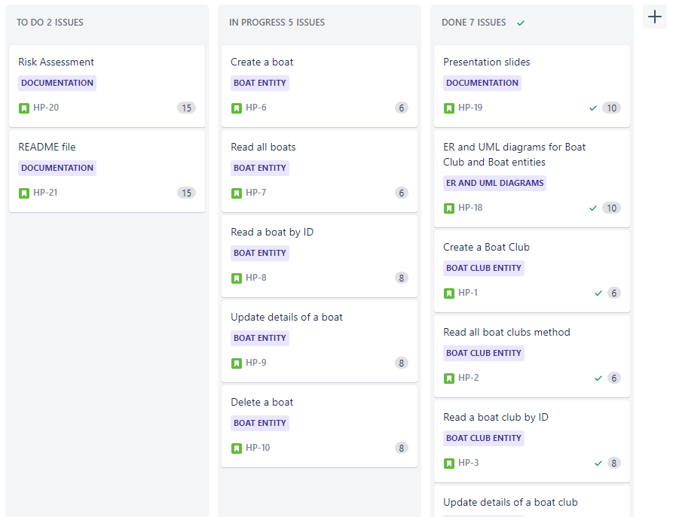
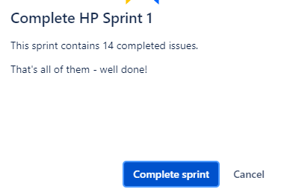
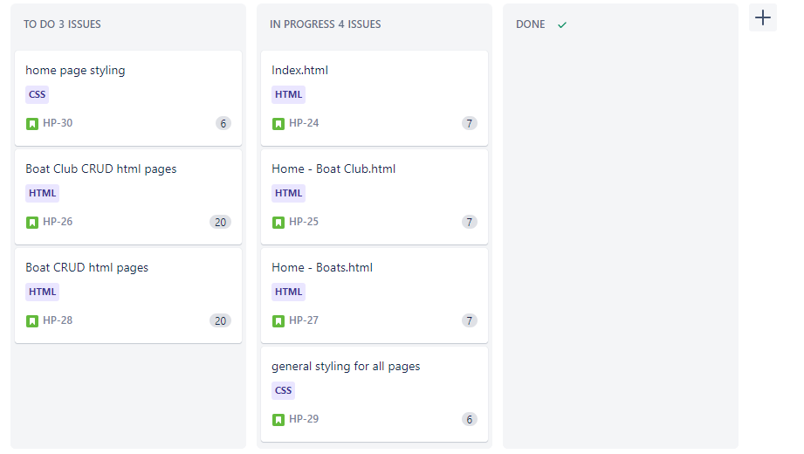
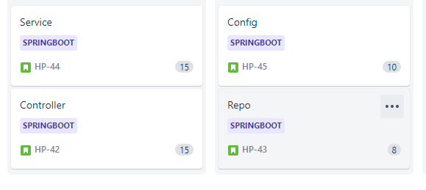
Initial Approach to the Project
Fairly decent level of confidence
More experience with Java from previous project
Willing to apply new things learned in HTML, CSS and JS
Getting better with using Jira and Git

Slide 3
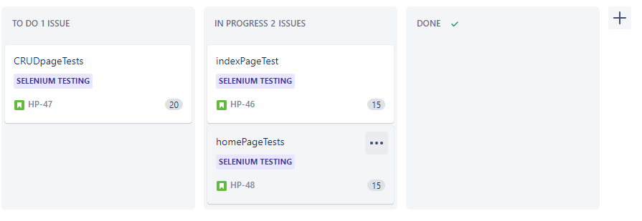
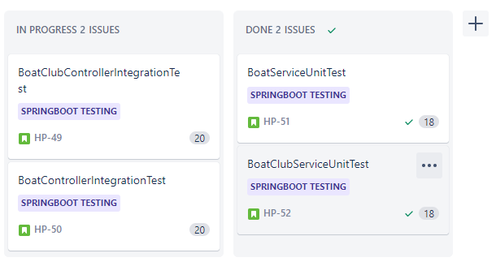

Slide 4
Sprint Plan
What must be included?
Fully functional HTML pages (navigating from page to page)
CRUD functionality in SpringBoot and web page
Selenium testing for front - end
A working web application page that can use CRUD
CSS styling (background images)
Sufficient test coverage from SpringBoot and Selenium

Slide 5
Consultant Journey
SpringBoot and Selenium (for testing both ends)
Fetch requests in JavaScript
Building up from test classes to writing unit and integration tests

Slide 6
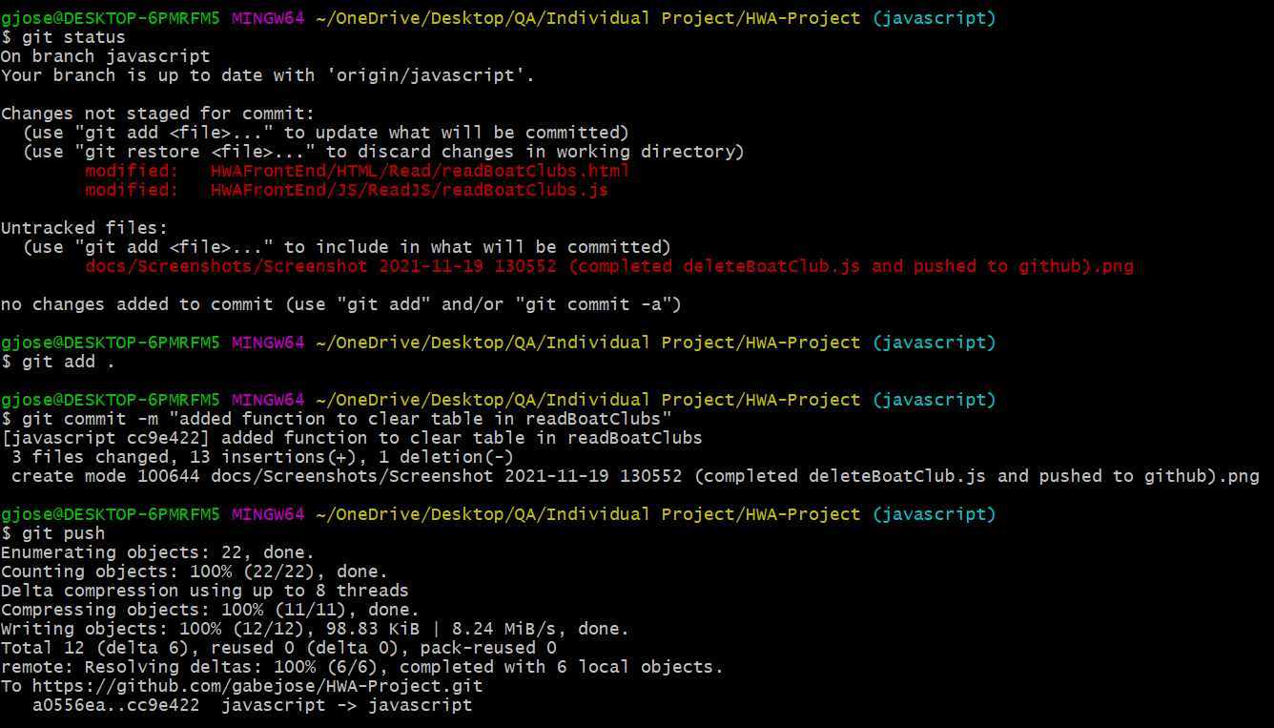
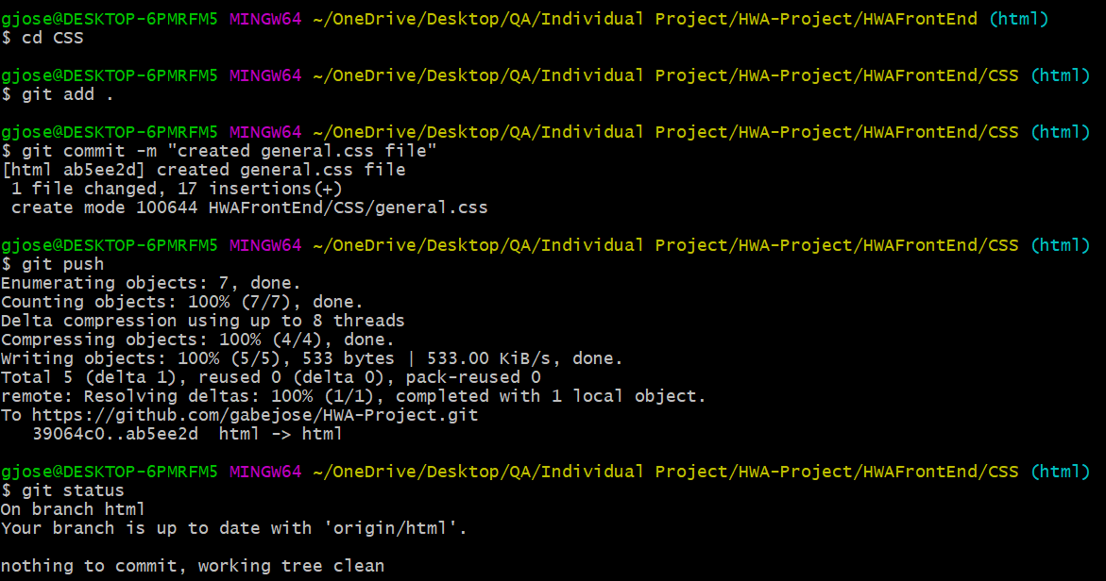
Version Control Approach
Being more strict with following the feature branch model when implementing new features to the project (e.g. docs, SpringBoot, Selenium, etc)
Was able to be more thorough with version control by pushing regularly to Git
Included one last general push to GitHub at the end of the day
Included a folder containing all screenshots of every push to GitHub in docs folder

Slide 7
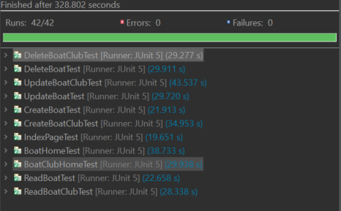
Testing
Front – end was tested by opening a live server on VS
Changed to Selenium by using ChromeDriver and running the tests
Selenium tests are complete and fully operational
Back – end testing was done initially by running Spring from the terminal and using Postman
Changed to unit and integration tests on SpringBoot
Coverage currently at 42.1 % due to problems (should improve before submission)

Slide 8
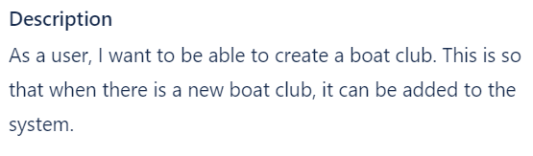
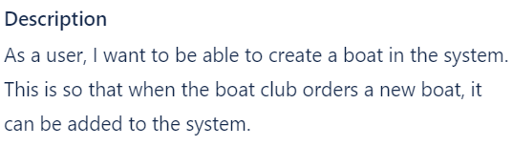
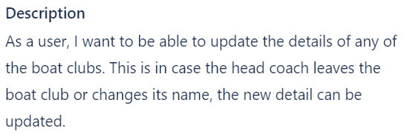
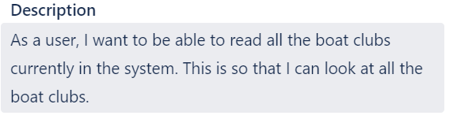
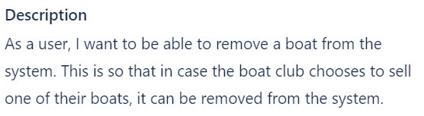
Demonstration
User stories I will cover on web page:
CREATE and READ boat clubs
CREATE boats
UPDATE a boat club
DELETE a boat

Slide 9
Sprint Review
Managed to complete:
Remaining tasks:
Fully functional web page (able to use CRUD)
Controllers, services, domains for Boat and BoatClub classes on SpringBoot
Documentation (Risk assessment, ER and UML diagram)
Mostly completed Jira board
Selenium tests
Fully working HTML and JS, sufficient styling using CSS
Fat .jar files for Selenium and SpringBoot
Merging final version from dev to main branch on GitHub
Integration tests for BoatController due to problems

Slide 10
Sprint Retrospective
What went well?
What to do better next time?
Took more careful planning for overall project
More disciplined with version control than with IMS
Slightly more consistent with code style
Basics of Java, HTML, CSS and JavaScript were properly demonstrated
Stuck to planned timeline for the project
Could still use smart commits for Jira (heavily focused on normal commits via Git bash)
Avoid wasting too much time trying to debug myself. Ask trainer for help or cohort members in breakout rooms on Teams

Slide 11
Overall Conclusion
Big improvement from IMS (as far as using Git)
Still could do a bit better
Keep working on getting into a better habit of updating Jira and project work simultaneously
Try to ask for help a bit more often instead of wasting a lot of time trying to do it myself

Slide 12
Thank you for listening!

Slide 13
Any questions?

